Slide 1



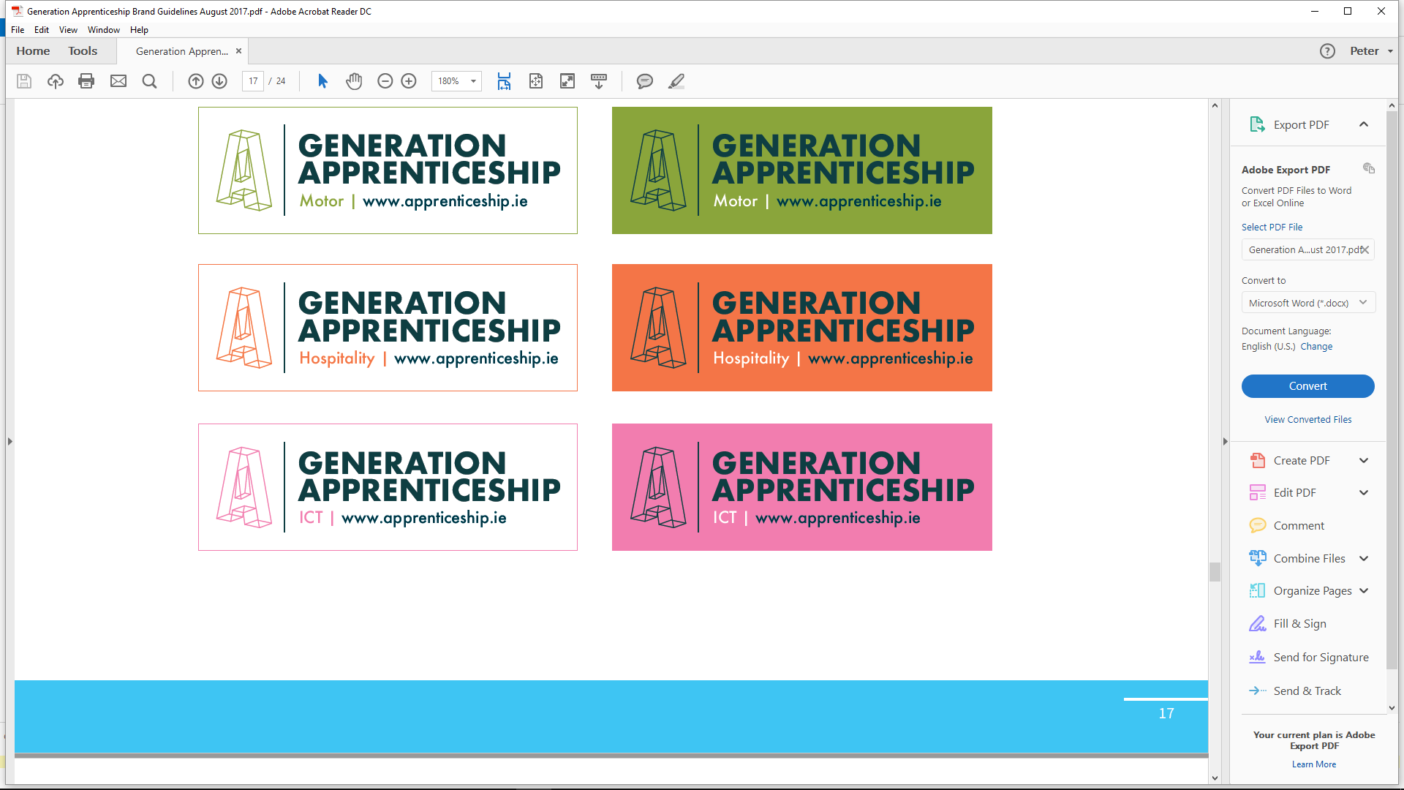



ICT ASSOCIATE PROFESSIONAL
building the tech talent pipeline…..

Slide 2
Overview of modern Apprenticeships
Apprenticeship is a programme of education and training which combines work place application with off the job training in a educational college / centre.
The Tech Apprenticeships are two-year programmes designed for Leaving Cert. students (18+) and adult learners wishing to pursue careers in the tech sector.
Apprentices are employed by approved employers while on the Apprenticeship programme – salary guide Yr1 €260 - €290 p.w. / Yr2 €340 - €385 p.w.
National training delivery in partnership
with 16 regional ETBs.
FIT is responsible for the governance
& operational management as national
Coordinating Provider for Tech
Apprenticeships (NQF Level 6).

Slide 3
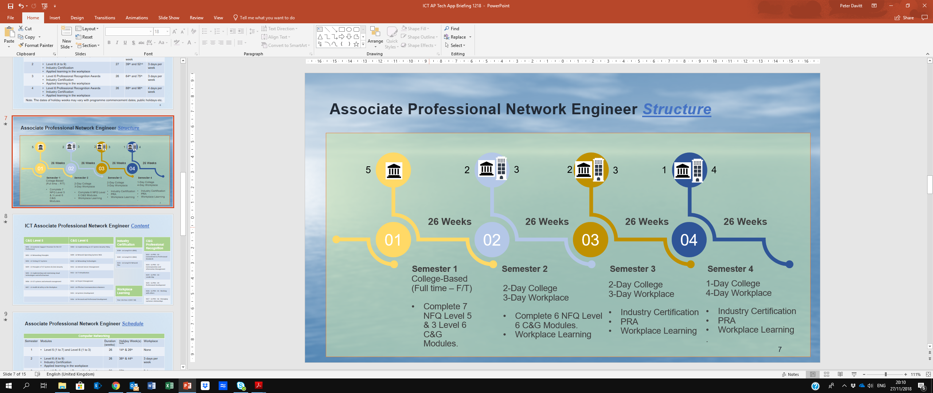
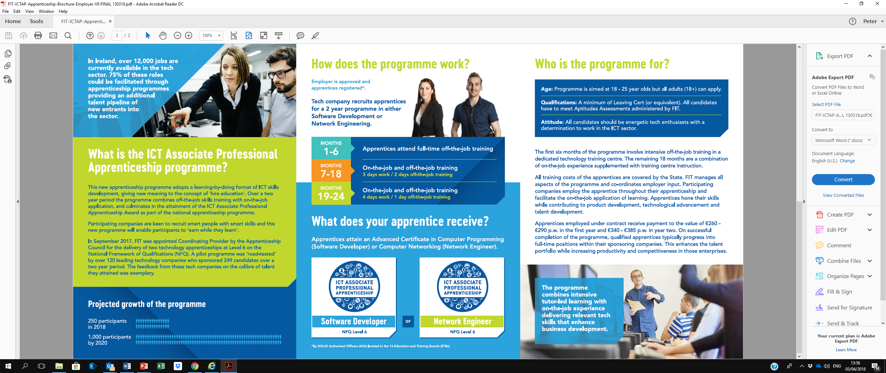
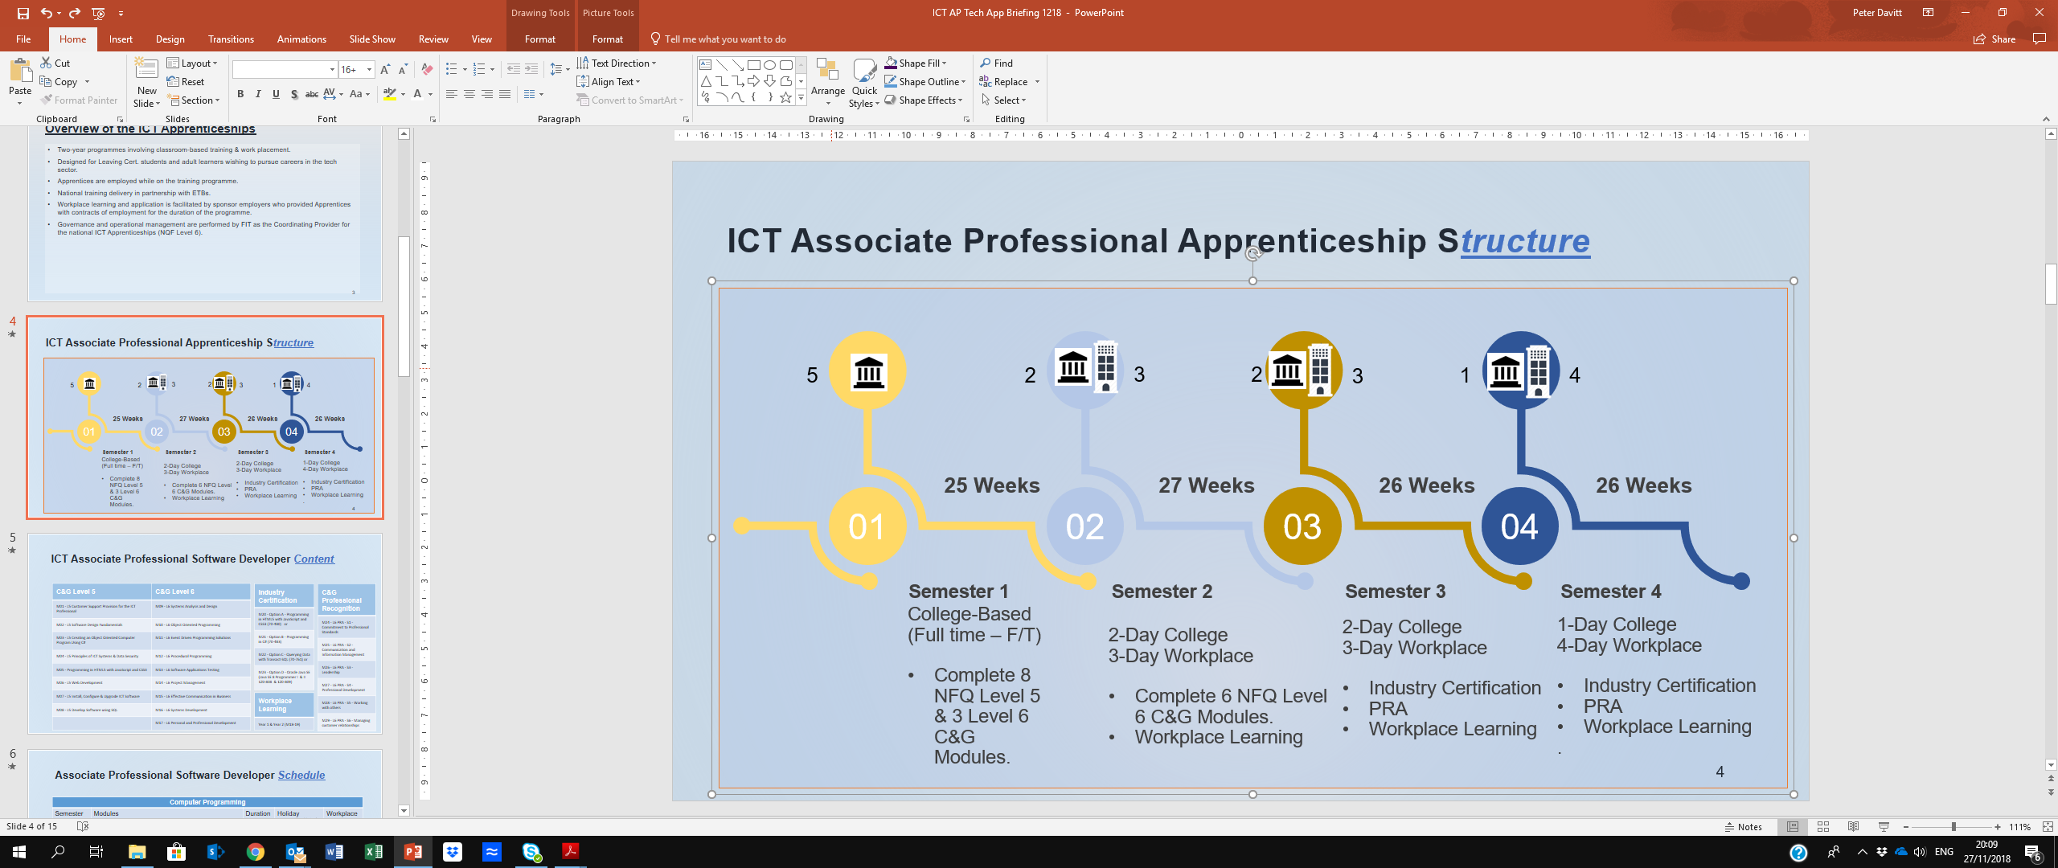
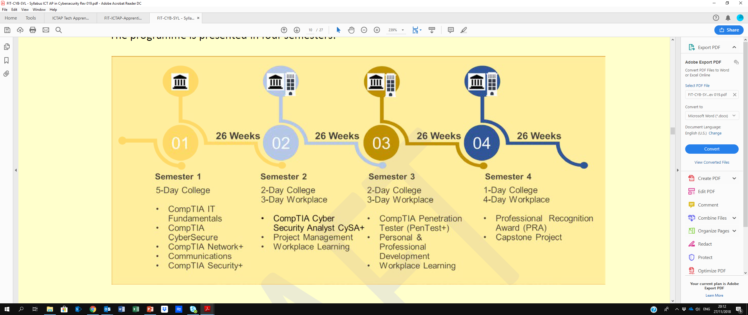
Tech Apprenticeship Structure
Cyber Security

Slide 4
ICT AP - Software Developer Apprenticeship:
ICT AP Software Developer NFQ Level 6 Modules:
M01 - L5 Customer Support Provision for the ICT Professional | M09 - L6 Systems Analysis and Design
M02 - L5 Software Design Fundamentals | M10 - L6 Object Oriented Programming
M03 - L5 Creating an Object Oriented Computer Program Using C# | M11 - L6 Event Driven Programming Solutions
M04 - L5 Principles of ICT Systems & Data Security | M12 - L6 Procedural Programming
M05 - Programming in HTML5 with JavaScript and CSS3 | M13 - L6 Software Applications Testing
M06 - L5 Web Development | M14 - L6 Project Management
M07 - L5 Install, Configure & Upgrade ICT Software | M15 - L6 Effective Communication in Business
M08 - L5 Develop Software using SQL | M16 - L6 Systems Development
*C&G Modules | M17 - L6 Personal and Professional Development
Industry Certification
M20 - Option A - Programming in HTML5 with JavaScript and CSS3 (70-480) or
M21 - Option B - Programming in C# (70-483)
M22 - Option C - Querying Data with Transact-SQL (70-761) or
M23 - Option D - Oracle Java SE (Java SE 8 Programmer I & II 1Z0-808 & 1Z0-809)
C&G Professional Recognition
M24 - L6 PRA - S1 - Commitment to Professional Standards
M25 - L6 PRA - S2 - Communication and Information Management
M26 - L6 PRA - S3 - Leadership
M27 - L6 PRA - S4 - Professional Development
M28 - L6 PRA - S5 - Working with others
M29 - L6 PRA - S6 - Managing customer relationships
Workplace Learning
Year 1 & Year 2 (M18-19)

Slide 5
ICT AP - Network Engineer Apprenticeship:
ICT AP Network Engineer NFQ Level 6 Modules:
M01 - L5 Customer Support Provision for the ICT Professional | M08 – L6 Implementing an ICT System Security Policy
M02 - L5 Networking Principles | M09 - L6 Network Operating Systems NOS
M03 - L5 Testing ICT Systems | M10 - L6 Networking Technologies
M04 - L5 Principles of ICT Systems & Data Security | M11 - L6 Internet Server Management
M05 - L5 Implementing and maintaining cloud technologies and infrastructure | M12 - L6 IT Virtualisation
M06 - L5 ICT systems and network management | M13 - L6 Project Management
M07 - L5 Health & Safety in the Workplace | M14 - L6 Effective Communication in Business
 | M15 - L6 Systems Development
*C&G Modules | M16 - L6 Personal and Professional Development
Industry Certification
M19 - L6 CompTIA A (901)
M20 - L6 CompTIA A (902)
M21 - L6 CompTIA Network Plus
C&G Professional Recognition
M22 - L6 PRA - S1 - Commitment to Professional Standards
M23 - L6 PRA - S2 - Communication and Information Management
M24 - L6 PRA - S3 - Leadership
M25 - L6 PRA - S4 - Professional Development
M26 - L6 PRA - S5 - Working with others
M27 - L6 PRA - S6 - Managing customer relationships
Workplace Learning
Year 1 & Year 2 (M17-18)

Slide 6
ICT AP – Cyber Security Apprenticeship:
Cyber Security
ICT AP Network Engineer NFQ Level 6 Modules:
M01 - CompTIA IT Fundamentals | M07 - Application of skills in the workplace (Y1)
M02 - CompTIA Network + | M08 - CompTIA Penetration Tester Pentest+
M03 - Effective Communication in Business | M09 - Personal & Professional Development
M04 - CompTIA Security + | M10 – Application of Skills in the Workplace (Y2)
M05 - CompTIA Cybersecurity Analyst CySA+ | M11 - Professional Recognition Award
M06 - Project Management | M12 - Capstone Project
*C&G Modules
Industry Certification
CompTIA Network + (N10-007)
CompTIA Security + (SY0-501)
CompTIA Cyber Security Analyst CySA+ (CS0-001)
CompTIA Penetration Tester Pentest+ (PT0-001)
Professional Recognition Components
M11 - L6 PRA - S1 - Commitment to Professional Standards
M11 - L6 PRA - S2 - Communication and Information Management
M11 - L6 PRA - S3 - Leadership
M11 - L6 PRA - S4 - Professional Development
M11 - L6 PRA - S5 - Working with others
M11 - L6 PRA - S6 - Managing customer relationships
Workplace Learning
Year 1 & Year 2 (M7-10)

Slide 7
Building a portfolio of Tech Apprenticeships to deliver a talent pipeline of 1,000 ICT Associate Professionals p.a. by 2021:
Cyber Security
Fin Tech
DevOps
Data Centre
Digital Forensics
Data Analyst
Virtualisation
Med Tech

Slide 8
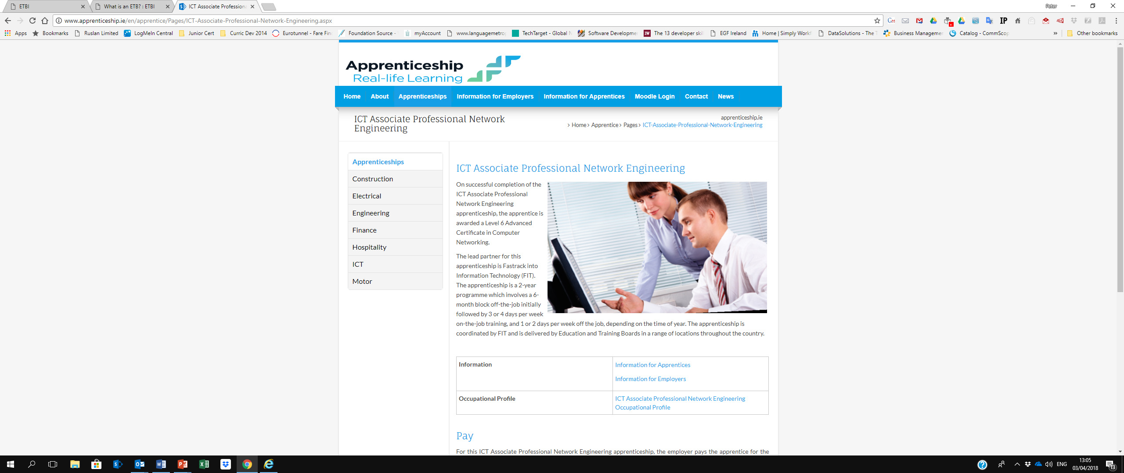
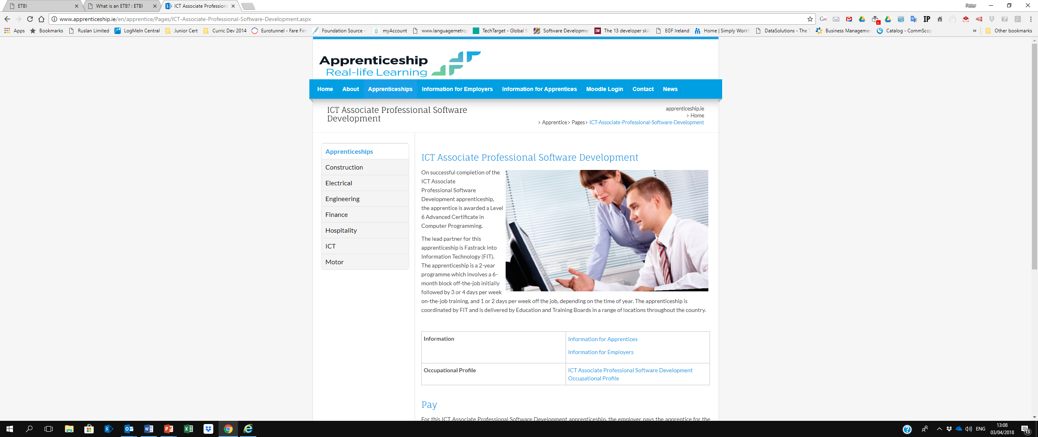
National Roll-Out:
ICT Associate Professional in Cyber Security
35 Tech Apprenticeships in 2019 → 45 Tech Apprenticeships in 2020 → 65 Tech Apprenticeship 2021
The Government (CIO) is adopting the ICT Apprenticeships to develop tech talent within the Civil Service.

Slide 9

1,000 Tech Apprentices p.a. by 2021
Cyber Security

Slide 10






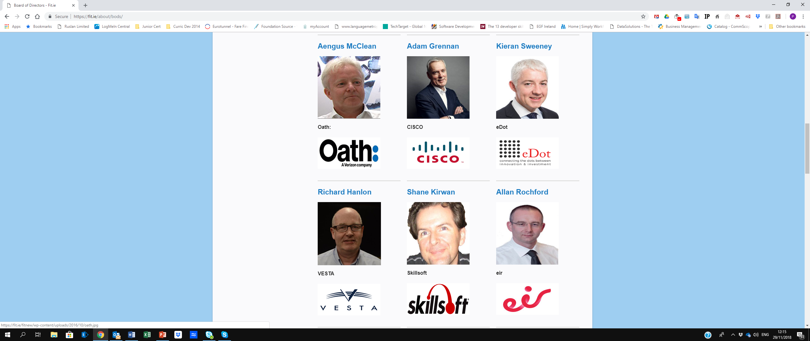
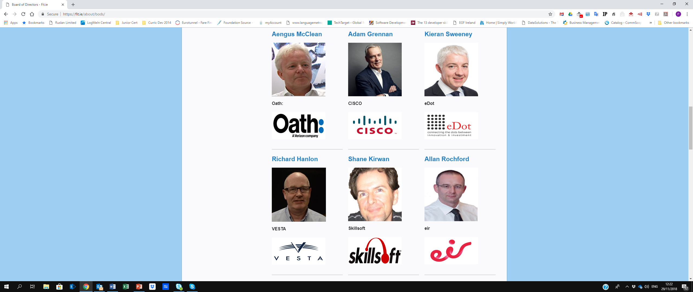
FIT Board of Directors:
Further Information:
FIT Ltd. | Phone: +353 1 8825570 Email: info@fit.ie Web: http://fit.ie/techapprenticeships/
Apprenticeship Programme Director | George Ryan | georgeryan@fit.ie | 0862449536
Operations Manager | Edel Hesnan | edelhesnan@fit.ie | 0860276903

